Slide 1

Divisibility and Modular Arithmetic
This presentation covers divisibility, prime numbers, GCD, LCM, and modular arithmetic. We will explore key theorems like the Division Algorithm and the Euclidean Algorithm. Examples and applications will illustrate these concepts.

Slide 2
Modular Arithmetic
Definition of Modulo
Addition
Multiplication
a ≡ b (mod m) means a and b have the same remainder when divided by m.
(a + c) ≡ (b + d) (mod m). Modular arithmetic preserves addition.
(ac) ≡ (bd) (mod m). Multiplication is also preserved in modular arithmetic.

Slide 3
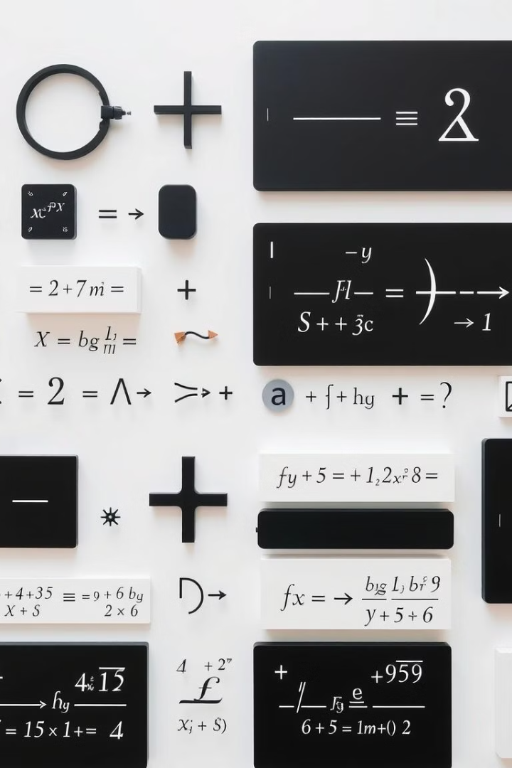
Key Definitions and Concepts
Divisibility
Prime Numbers
𝑎 divides 𝑏 if there exists an integer 𝑐 such that 𝑏 = 𝑎𝑐. Notation: 𝑎 ∣ 𝑏. Example: 3 ∣ 12 because 12 = 3 × 4.
An integer greater than 1 with exactly two divisors: 1 and itself. Example: 2, 3, 5, 7, 11, etc. A composite number has more than two distinct divisors.
GCD and LCM
GCD of 𝑎 and 𝑏 is the largest integer that divides both. LCM is the smallest positive integer divisible by both. gcd(𝑎, 𝑏) × lcm(𝑎, 𝑏) = 𝑎 × 𝑏.

Slide 4
Key Theorems
Division Algorithm
Properties of Divisibility
Euclidean Algorithm
For integers 𝑎 and 𝑏 > 0, there exist unique integers 𝑞 and 𝑟 such that 𝑎 = 𝑏𝑞 + 𝑟, 0 ≤ 𝑟 < 𝑏. Example: 17 = 5(3) + 2.
If 𝑎 ∣ 𝑏 and 𝑏 ∣ 𝑐, then 𝑎 ∣ 𝑐 (Transitivity)
gcd(𝑎, 𝑏) = gcd(𝑏, 𝑎 mod 𝑏). Example: gcd(252, 105): 252 mod 105 = 42, gcd(105, 42) = gcd(42, 21) = 21.
If 𝑎 ∣ 𝑏, then 𝑎 ∣ (𝑏 + 𝑐) and 𝑎 ∣ (𝑏 − 𝑐)
If 𝑎 ∣ 𝑏 and 𝑎 ∣ 𝑐, then 𝑎 ∣ (𝑚𝑏 + 𝑛𝑐)

Slide 5
Modular Arithmetic
𝑎 ≡ 𝑏 (mod 𝑚) means 𝑎 and 𝑏 have the same remainder when divided by 𝑚, i.e., 𝑚 ∣ (𝑎 − 𝑏). Example: 17 ≡ 5 (mod 6) since 17 − 5 = 12 is divisible by 6.
Addition
Subtraction
Multiplication
Exponentiation
(𝑎 + 𝑐) ≡ (𝑏 + 𝑑) (mod 𝑚)
(𝑎 − 𝑐) ≡ (𝑏 − 𝑑) (mod 𝑚)
(𝑎𝑐) ≡ (𝑏𝑑) (mod 𝑚)
𝑎^𝑛 ≡ 𝑏^𝑛 (mod 𝑚)

Slide 6
Integer Representations and Algorithms
Number Representation
Base Conversions
Numbers can be shown in different bases. Base b uses digits from 0 to b-1.
Decimal to Binary uses repeated division by 2. Record the remainders. Read remainders from bottom to top.
(𝑛𝑘𝑛𝑘−1…𝑛1𝑛0)𝑏 = 𝑛𝑘𝑏𝑘 + 𝑛𝑘−1𝑏𝑘−1 + ⋯ + 𝑛1𝑏1 + 𝑛0𝑏0.
Example: 25 ÷ 2 = 12 R1, 12 ÷ 2 = 6 R0, 6 ÷ 2 = 3 R0, 3 ÷ 2 = 1 R1, 1 ÷ 2 = 0 R1. Thus, 25(10) = 11001(2).
Binary (Base 2): {0,1}
Octal (Base 8): {0,1,2,3,4,5,6,7}
Binary to Decimal uses the weighted sum method. Multiply each binary digit by its power of 2 and sum the results.
Decimal (Base 10): {0,1,2,3,4,5,6,7,8,9}
Hexadecimal (Base 16): {0,1,2,3,4,5,6,7,8,9,A,B,C,D,E,F}
Example: 1x2^4 + 1x2^3 + 0x2^2 + 0x2^1 + 1x2^0 = 16 + 8 + 0 + 0 + 1 = 25(10).

Slide 7
Integer Algorithms
1
Addition in Different Bases
2
Multiplication
Follow standard base-10 addition rules. Add digits from right to left, carrying when the sum exceeds the base. Remember to convert any carry values into the appropriate digit in the target base.
Uses base-specific addition rules. Follow the multiplication rules, creating partial products and then summing them using base-specific addition. Ensure proper alignment of digits according to their place value.
3
Modular Exponentiation
4
Euclidean Algorithm
Efficiently computes a^b mod m using squaring. Convert the exponent b to binary, and then iteratively square a and reduce modulo m based on the binary representation of b.
Finds the GCD of two integers using repeated division. Divide the larger number by the smaller, and then replace the larger with the smaller and the smaller with the remainder. Stops when the remainder is zero; the last non-zero remainder is the GCD.

Slide 8
Solving Congruences
Linear Congruence Definition
Existence of Solutions
Solving with Inverse
A solution exists for 𝑎𝑥 ≡ 𝑏 (mod 𝑚) if gcd(𝑎, 𝑚) divides 𝑏.
If gcd(𝑎, 𝑚) = 1, find 𝑎's modular inverse modulo 𝑚.
A linear congruence is defined as 𝑎𝑥 ≡ 𝑏 (mod 𝑚).
If gcd(𝑎, 𝑚) = 𝑑 divides 𝑏, the congruence has 𝑑 solutions.
Multiply both sides of the congruence by this inverse to solve for 𝑥.
Here, 𝑎, 𝑏, and 𝑚 are integers, and 𝑥 is the unknown integer.

Slide 9
Applications of Congruences
1
Cryptography
2
Secure Hashing
RSA relies on the difficulty of factoring large primes, which are fundamental to encrypting and decrypting sensitive data.
Hashing uses prime-based math to map data, ensuring that each input produces a unique output. This method is crucial for data integrity and security.
3
Error Detection
4
PRNG
Check digits use modular math to detect errors in identification numbers, bank routing numbers and more. Using check digits minimizes data entry errors.
Random number generators use modular arithmetic to create sequences that appear random but are reproducible, making them vital for simulations and cryptography.

Slide 10
Cryptography
Classical Cryptography
Public Key Cryptography
Modern Concepts
Caesar Cipher: Shift letters by a fixed number.
RSA Algorithm: Key generation, encryption, and decryption.
Homomorphic Encryption: Computations on encrypted data.
Shift Cipher: Generalization of Caesar cipher.
Public vs. Private Key Cryptography: No prior key sharing.
Quantum Computing Threat: May break RSA security.
Cryptanalysis: Methods for breaking ciphers.

